Slide 1
Sliding Puzzle
Group 5394_RR_3
Kidambi Sekar, Aarthy (a_k196)
Umbarkar, Reena (r_u22)
Vanipenta, Manoj Kumar (m_v219)
Zhou, Pingheng (p_z12)

Slide 2
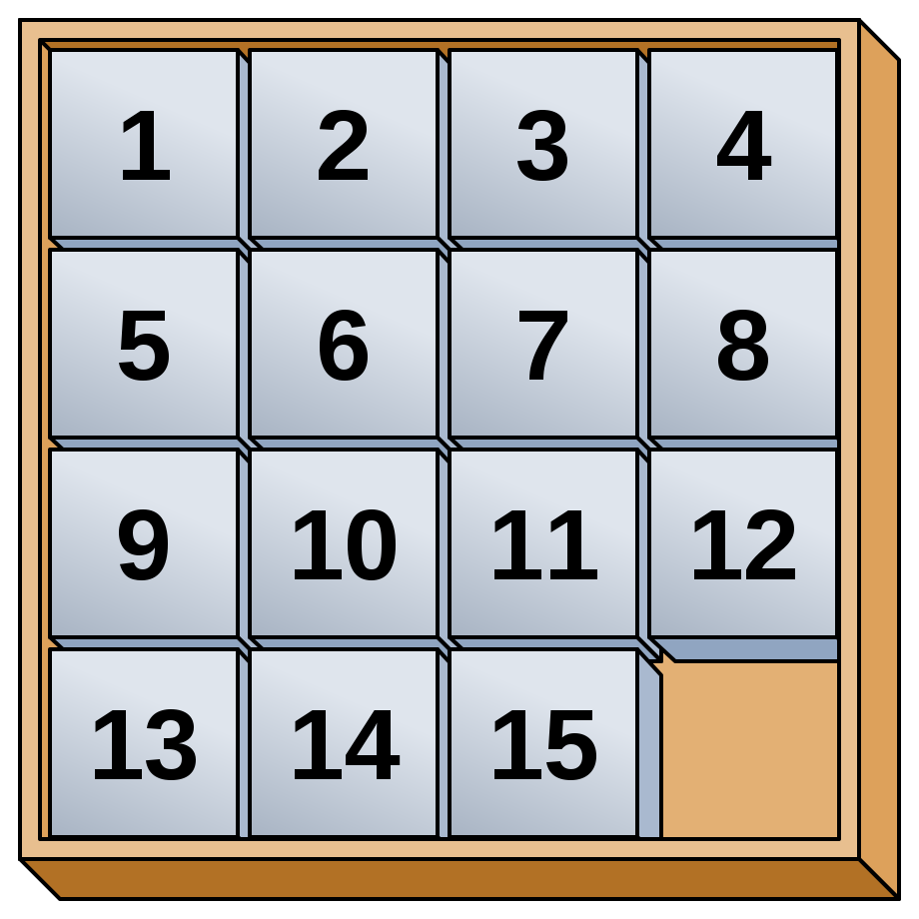
Introduction
A sliding tile number puzzle is a combination (sequential move) puzzle

Slide 3
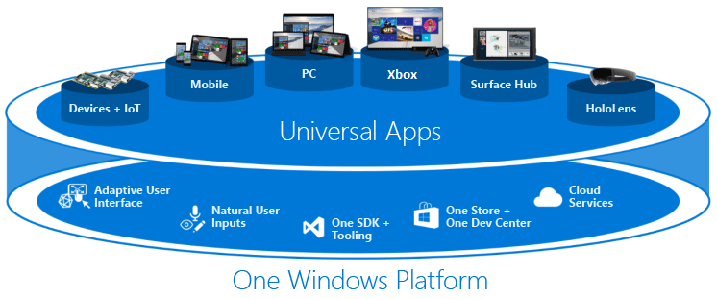
Implementation - Platform
Universal Windows Platform

Slide 4
Implementation – Dev Environment
Language – C#.NET (4.6)
IDE : Visual Studio 2015
Project type : UWP
Unit test framework : Visual Studio Unit Testing Framework
Tools: ReSharper, Visual Studio
Data Storage : Azure Cloud – No SQL – Azure tables
Design : MVVM

Slide 5
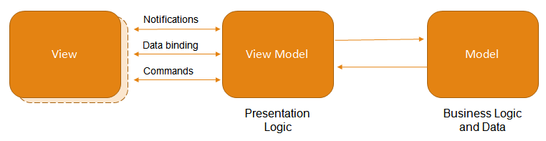
Implementation : MVVM

Slide 6
Puzzle – Core Functionalities
Login
Register
New game
Save game
Load Saved Game
Solve game
Using puzzle randomizing data
AI approach - A* algorithm

Slide 7
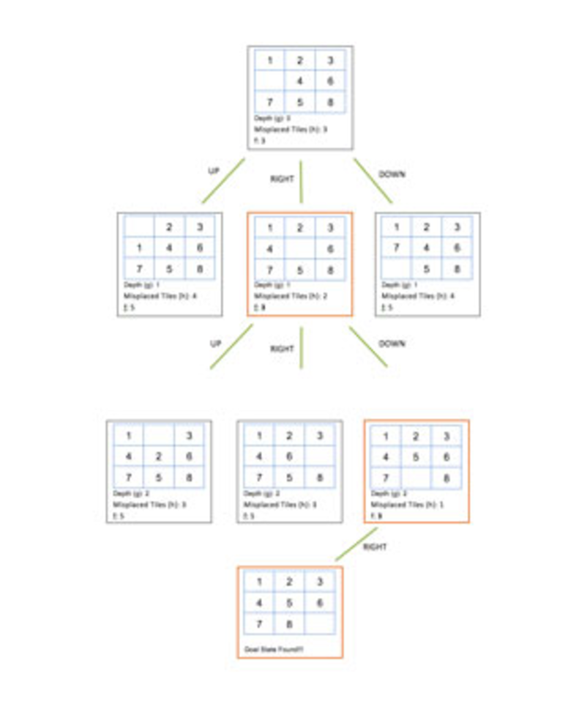
A* algorithm
searches the universe of all possible board configurations using an Informed Search
Uses heuristics : Based on value
assigned to each state

Slide 8
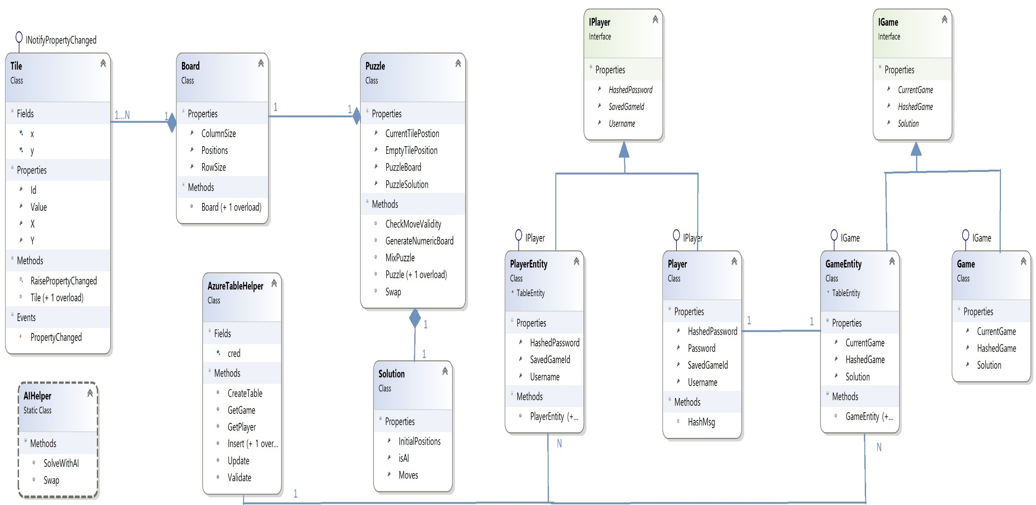
Class diagram

Slide 9
Demo

Slide 10
References
https://en.wikipedia.org/wiki/Sliding_puzzle
https://docs.microsoft.com/en-us/windows/uwp/get-started/universal-application-platform-guide
https://visualstudiomagazine.com/articles/2015/10/30/sliding-tiles-c-sharp-ai.aspx
https://documentation.devexpress.com/windowsforms/113955/Build-an-Application/WinForms-MVVM

